Slide 1
Conductors and Insulators

Slide 2
Explain what a conductor or an insulator is.
Compare a conductor and insulator and how they relate to heat transfer.
Identify whether an object or material is a conductor or insulator.

Slide 3
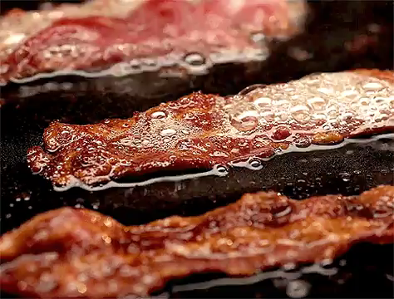
Conductors are materials that transfer heat quickly.
Metals are excellent conductors - you will know this if you ever touched the side of a hot pan! The heat from the stove burner is spread over the whole pan and then when you touch the pan the heat is quickly transferred to you.

Slide 4
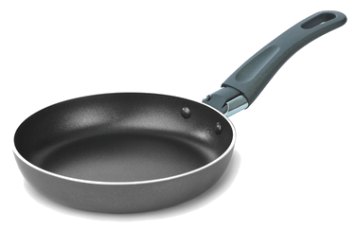
Insulators transfer heat very, very slowly.
Some examples of insulators are plastic, wood, cloth, and rubber.
For example, the plastic handle on a pan is an insulator. This means that we can lift a hot pan by the handle without burning ourselves!

Slide 5
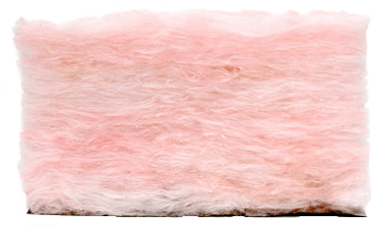
We also keep insulators in our walls and roof.
This insulation means that heat from our houses is lost to the environment much more slowly, keeping our houses warm for longer.
In fact, we often build our houses out of material that acts as an insulators such as wood, brick and glass.

Slide 6
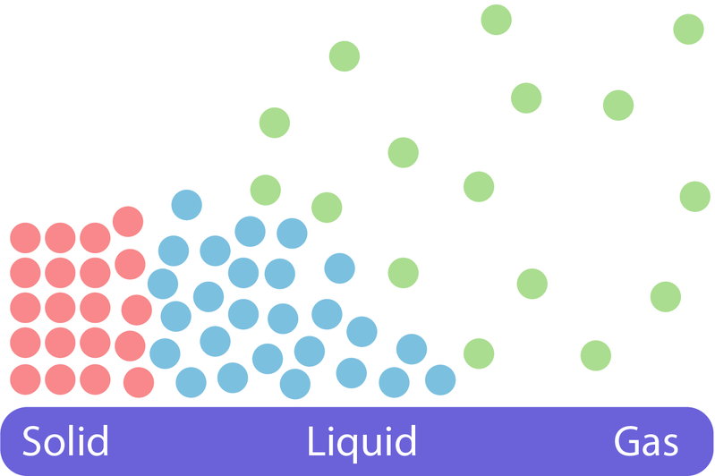
Gases are very good insulators.
This is because particles in gases are spread far apart so they don't bump into each other.
Remember that heat is transfered by particles colliding.

